Slide 1
Interactive Correction of Mislabeled Training Data
VAST 2019

Slide 2
Abstract
We employ a bi-level optimization model to accurately match the labels of the trusted items and to minimize the training loss.
Based on this model, a scalable data correction algorithm is devel-oped to handle tens of thousands of labeled data efficiently. The selection of the trusted items is facilitated by an incremental tSNE with improved computational efficiency and layout stability to ensure a smooth transition between different levels.

Slide 3
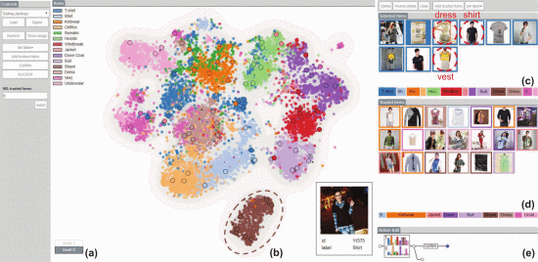
DataDebugger

Slide 4
Contributions
We develop a hierarchical visualization, supported by an incremental tSNE and an outlier biased sampling, for exploration of large scale datasets with improved stability and facilitating the identification of label errors.
We develop a scalable data correction algorithm that is applicable to data of multiple classes and of large scales and provide a visual solution for choosing trusted items.
We integrate the above techniques into a visual analysis tool that provides experts a practical way to debug and correct label errors in training data iteratively.

Slide 5
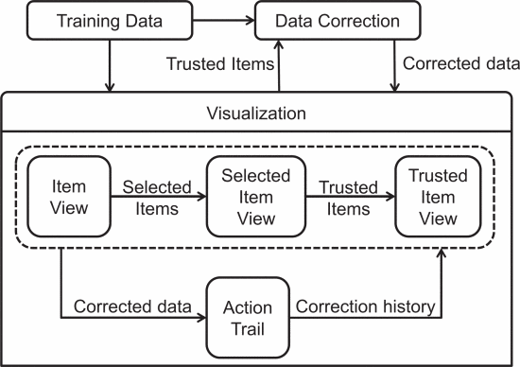
System Pipeline
Challenges :
R1. Handling large-scale data.
R2. Examining unusual distribution for identifying labeling errors.
R3. Recommending and verifying trusted items.
R4. Exploring the details.

Slide 6
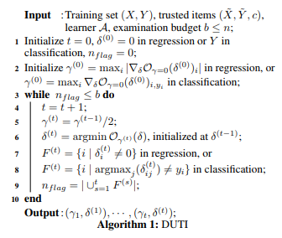
DUTI
We propose a novel algorithm DUTI (Debugging Using Trusted Items) which can detect both outlier and systematic training set bugs. In addition, it can propose fixes, namely the corrected label for the bugs. To do so, DUTI utilizes the knowledge of the machine learning algorithm and a small set of additional “trusted items”. At its core, DUTI finds the smallest changes to the training set such that, when trained on the changed training set, the learned model agrees with the trusted items. The changes are then shown to a domain expert as suggested bug fixes.

Slide 7
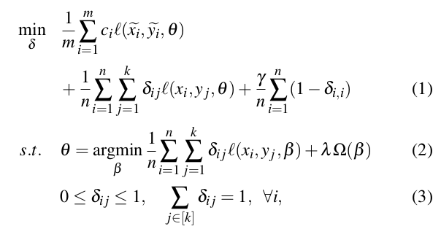
DUTI
通过传播一小组受信任项中的标签来自动检测并修复训练集中的潜在标签错误。其目的是对训练集的标签进行最小的更改，以使学习的分类模型正确地预测可信任项目的标签并修改其余项目的标签。
where δ i is a k-dimensional vector with its j-th element δ i j denoting the probability of the sample x i belong to class y j , and Ω(β ) is a regularizer to control the complexity of the classification model β .

Slide 8
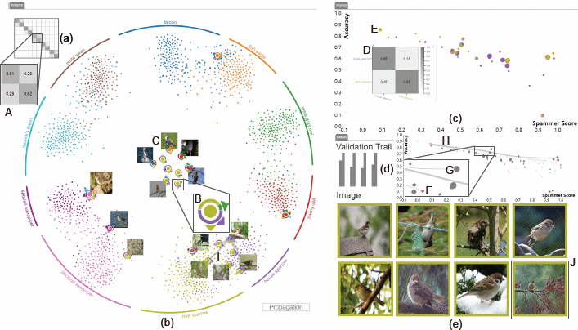
LabelInspect
The main contributions of our work are:
A visual analytics tool that allows data scientists to verify crowdsourced instance labels and unreliable workers in a convenient and fast manner.
An iterative and progressive verification procedure that propagates the influence of expert validations on both instance labels and worker reliabilities to recommend the most informative ones for further verification.
A novel instance visualization based on a well-formulated constrained t-SNE, a worker visualization conveying both global and partial spammer behaviors, and a confusion visualization.

Slide 9
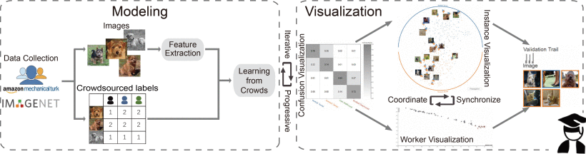
LabelInspect
LabelInspect overview: the data modeling module estimates correct labels from crowdsourced annotations and updates the labeling results based on expert validation; the visualization module allows analysts to interactively validate instance labels and spammer workers.

Slide 10
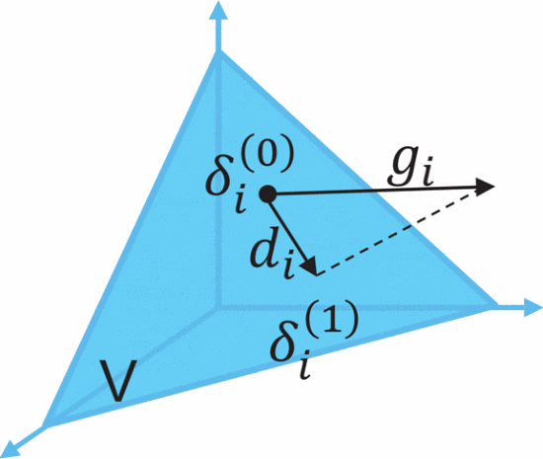
Scalability Improvement
We adopt two optimization strategies to further speed up the algorithm:
1) dimension reduction to reduce the dimension of the feature vector (Principal Component Analysis (PCA) [24] to reduce
the feature dimension)
2) greedy gradient projection to solve the above constrained optimization problem efficiently.(the method first computes
the gradient direction (g i ) by the steepest gradient algorithm, and then projects the search direction to the subspace tangent to the constraints. Through such a gradient projection, we obtain a gradient direction that satisfies the constraints.)

Slide 11
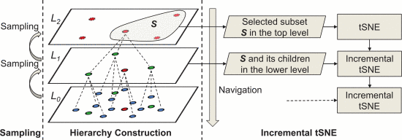
HIERARCHICAL VISUALIZATION IN DATA DEBUGGER
The proposed hierarchical representation. Left: sampling for building a higher layer; Middle: an item tree with three levels. Right: Navigating items through the hierarchical structure and incremental tSNE.

Slide 12
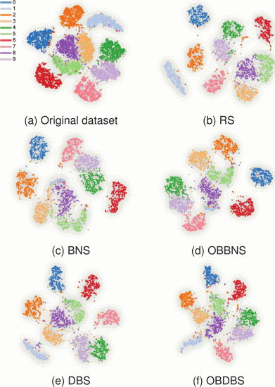
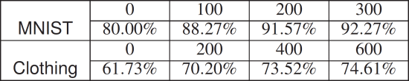
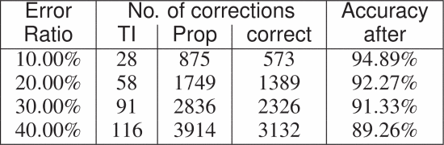
The tSNE projections of the MNIST dataset.

Slide 13
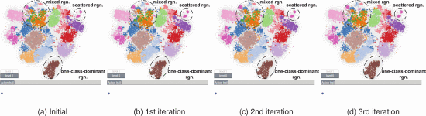
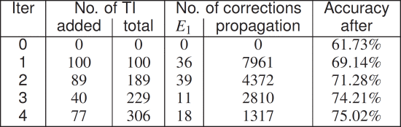
Top-level item distribution through the iterations
Numerical experiments on different error rate in MNIST.

Slide 14
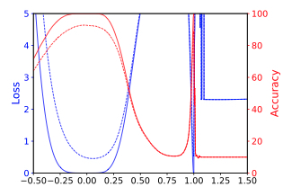
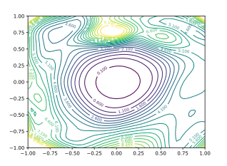
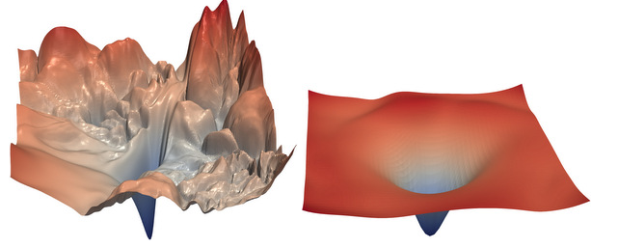
Visualizing the Loss Landscape of Neural Nets
In this paper, we explore the structure of neural loss functions, and the effect of loss landscapes on generalization, using a range of visualization methods. First, we introduce a simple “filter normalization” method that helps us visualize loss function curvature, and make meaningful side-by-side comparisons between loss functions. Using this method, we explore how network architecture affects the loss landscape, and how training parameters affect the shape of minimizers.

Slide 15
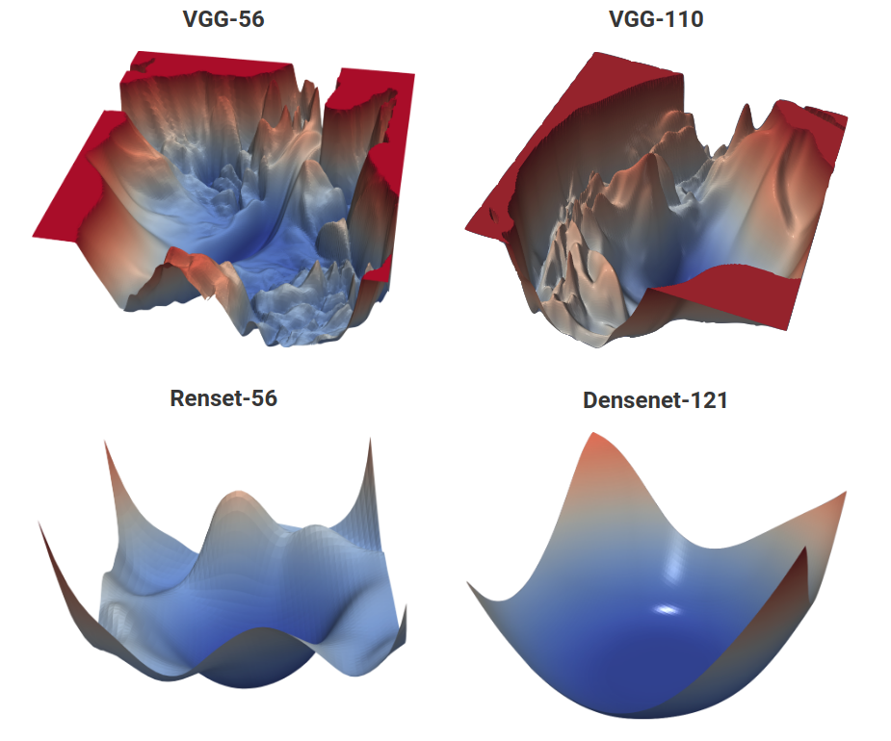
VISUALIZING THE LOSS LANDSCAPE OF NEURAL NETS
Neural loss functions with and without skip connections. The top row depicts the loss function of a 56-layer and 110-layer net using the CIFAR-10 dataset, without residual connections. The bottom row depicts two skip connection architectures. We have Resnet-56 (identical to VGG-56, except with residual connections), and Densenet (which has a very elaborate set of skip connections). Skip connections cause a dramatic "convexification" of the loss landscape.

Slide 16
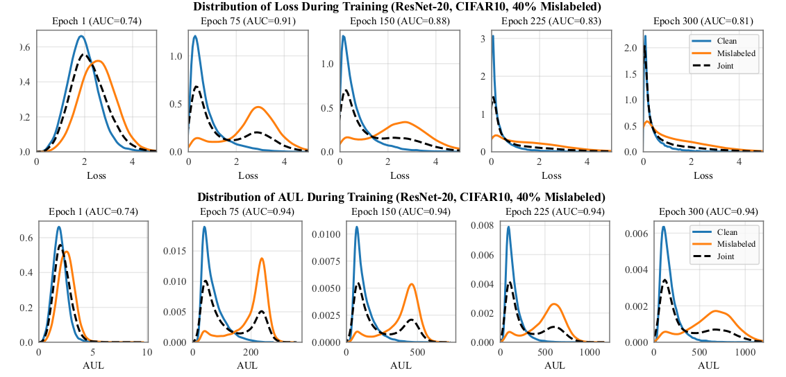
DETECTING LABEL NOISE FROM LOSS CURVES

Slide 17
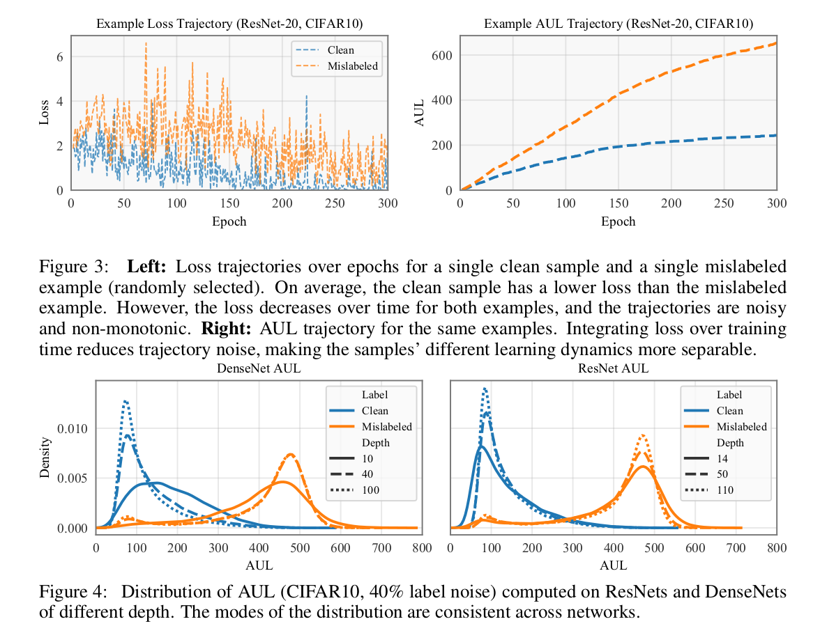
DETECTING LABEL NOISE FROM LOSS CURVES

Slide 18
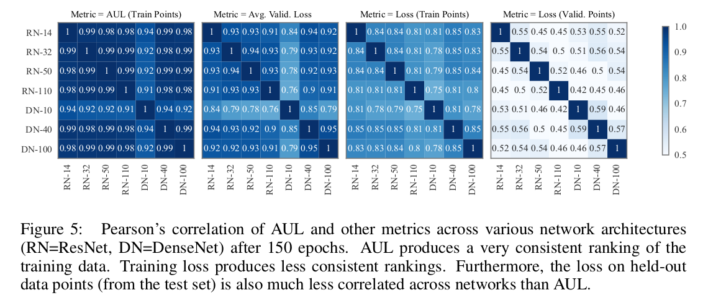
DETECTING LABEL NOISE FROM LOSS CURVES

